Slide 1

Analysis of Joe Root’s all International Cricket Centuries
Data Warehouse
Final Project

Slide 2

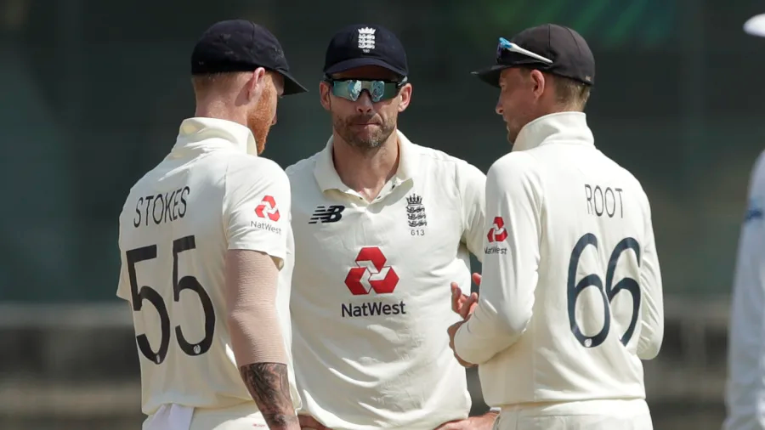

Our Team
KUHDSE22.1F-018
KUHDSE22.1F-023
KUHDSE22.1F-004
KUHDSE22.1F-019

Slide 3

Who is Joe Root?
Our dataset is Joe Root’s All International Cricket
Centuries
Was captain of the team
Senior cricketer in the team
Allrounder cricketer in England team
Has scored 46 international centuries
Has played 100 Test matches / 150 ODIs / 30 T20Is

Slide 4
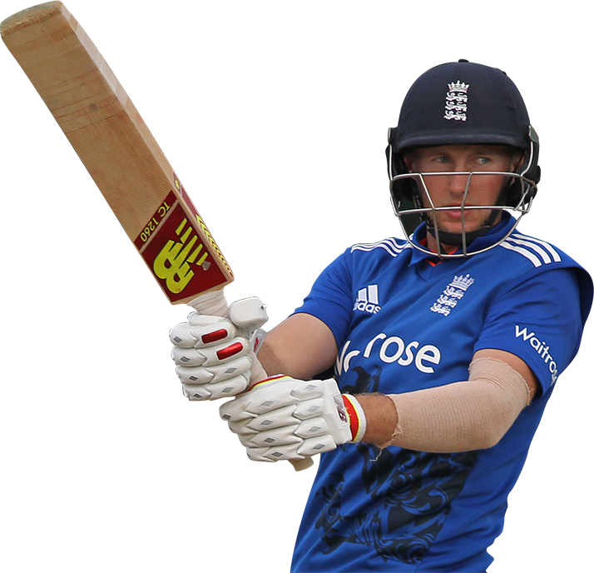
Why is dataset analyzed?
To analyze the performance
Get to know the trends, patterns, and factors
Give valuable insights to other international teams
Coaches to prepare the teams and plan the games
Identify the strengths and weaknesses
Improve and understand the development of skills
Analyze the Countries that the Joe Root has performed well

Slide 5

Original Data Set Features
No | Number of the row.
Score | Score that has been taken by the Joe Root of each match that he got centuries.
Against | The country against which Joe Root scored a century.
Position | The place in the team that Joe Root has played at that match.
Innings | The Inning that the Joe Root got the century.
Venue | The place that the match had been played
Ground | The ground place where the match had been played (Home/Away/Neutral)
Date | The date that the match had been hold.
Result | Th result of the match (Won/Lost/Drawn)

Slide 6
Data Preprocessing
No any missing values find, missing percentage of all attribute was 0%
Removed an unnecessary column that we do not need (“No” column)
Used “Interquartile Range” algorithm to check the outliers
No any outliers or any extreme values found

Slide 7
Data Transformation
Some of attributes were in numeric type and one attribute is a string type.
Score – String
Position - Numeric
Innings - Numeric
Used StringtoNominal algorithm to convert the string value of score to nominal
Used the method call discretize to convert the numerical values to categorical values
Position – 2 Bins (Top-Order, Middle-Order)
Innings – 4 Bins (1st, 2nd, 3rd , 4th )

Slide 8
Data Mining Process
We used: Apriori, Decision tree (J48), Naive Bayes algorithms, and Clustering (SimpleKMeans algorithm).
Apriori algorithm
First applied with the min_confidence = 0.9 and min_sup = 0.1
But considering the patterns were not reliable.
Then tried many times with changing the min_confidence and the min_sup
Finally we can got reliable patterns
min_confidence = 0.6 and min_sup = 0.4
Best rules found:
1. Ground=Home 26 ==> Result=Won 20 <conf:(0.77)>
2. Position=Middle-Order 29 ==> Result=Won 21 <conf:(0.72)>
3. Result=Won 31 ==> Position=Middle-Order 21 <conf:(0.68)>
4. Result=Won 31 ==> Ground=Home 20 <conf:(0.65)>

Slide 9
Data Mining Process
zeroR algorithm
Before adding any classifying algorithms we used zeroR algorithm
To compare the accuracy of other algorithms with zeroR
Correctly classified instances = 31 (67.39%)
Incorrectly classified instances = 15 (32.6%)
Accuracy by class the target variable we have used is Result.

Slide 10
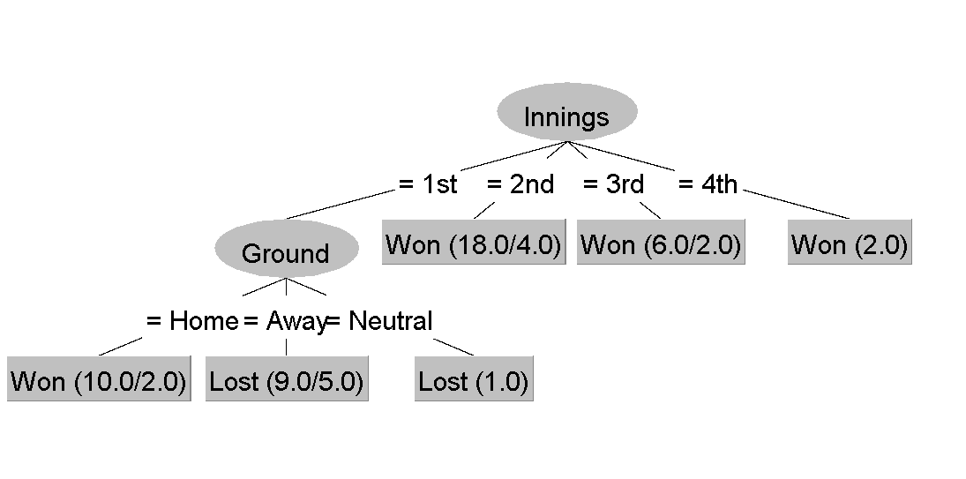
Data Mining Process
Decision tree(J48)
Correctly classified instances = 29 (63.04%)
Incorrectly classified instances = 17 (36.95%)
Tree view
Low accuracy
This algorithm did not work well with dataset

Slide 11
Data Mining Process
Decision tree(J48 Percentage split)
Training dataset = 66%
Testing dataset = 34%
Total instance = 16 from 46
Correctly classified instances = 14(87.5%)
Incorrectly classified instances = 2 (12.5%)
Tree view
High accuracy
This algorithm with particular training dataset has a good accuracy level

Slide 12
Data Mining Process
Naïve bayes algorithm
Used training set (entire dataset)
Correctly classified instances = 44(95.6522%)
Incorrectly classified instances = 2 (4.3478%)
We used Naïve bayes using percentage split but it did not work well with this dataset.both correctly classified instances and incorrectly classified instances were the same 50% and 50%
High accuracy
This algorithm show a high accuracy level. We can say that for this data set this algorithm is suitable

Slide 13
Data Mining Process
Clustering (simpleKMeans algorithm)
We needed to put 45 clusters to reduce the squared error
Number of iterations: 2
Within cluster sum of squared errors: 3.00
simpleKMeans algorithm with percentage split
We reduced no of clusters to 27
Number of iterations: 2
Within cluster sum of squared errors: 0.0
simpleKMeans algorithm with percentage split
We used 3 clusters
incorrectly clustered instances = 25.00 (54.3478 %)
After reduce clusters to 2. The incorrectly clustered instances were 18.0 (39.1304 %)
Low accuracy
This algorithm looks like low accuracy rate and did not work well with the dataset
High accuracy
Percentage split worked well with this dataset
We can say this algorithm also
Suitable to the dataset

Slide 14
Data Mining Process
Most Accurate algorithms that worked well with the dataset:
Apriori algorithm
J48 algorithm with percentage split a
Naive bayes algorithm using training set
clustering with classes to cluster evaluation (result attribute)
Results and patterns:
Identified Joe Root is performing well at home grounds.
He has taken most of the centuries at the home.
Performed as a middle order batsman.
Most of the matches that Joe Root performed well had won by the England (Game changer).
Has little bit low performance of matches that is playing away from home.
Away from home some of matches were lost even Joe Root performed well.
We can say England team is most comfortable to win the matches at home.

Slide 15
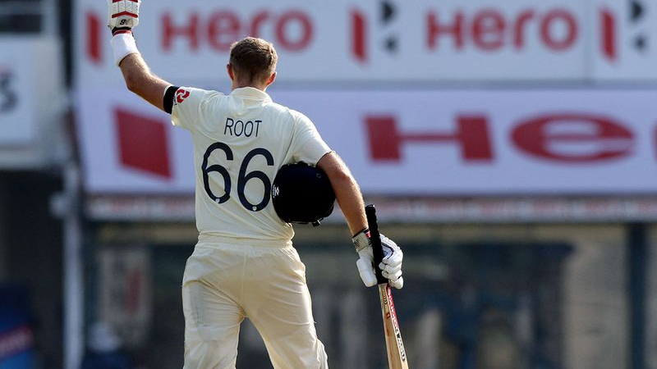
THANK YOU!

